Slide 1
13th session.
Forecasting P&L. Main ratios
Notes:
We will deal with financial topics slowly because, finally, we have to use numbers for things.

Slide 2
Balance
Assets
Liabilities and equity
Fixed
Assets
Equity
Long-term
liabilities
Current
Assets
Current
liabilities
Notes:
Spend many time in this slide and explain the initial balance of Bar Pepe S.L.

Slide 3
Corporate debt (comparing situations)
A
B
Sales
100
80
60
100
80
60
Cost of Goods Sold
60
48
36
60
48
36
General & Administration Expenses
20
20
20
20
20
20
Financial Expenses (15%)
0
0
0
7,5
7,5
7,5
Profit before tax
20
12
4
12,5
4,5
-3,5
Tax
7
4,2
1,4
4,375
1,575
0
Net Profit
13
7,8
2,6
8,125
2,925
-3,5
Return on Equity
13%
7,8%
2,6%
16,25%
5,85%
-7,00%
Identical assets with a value of 100. Company A: 0% debt. Company B: 50% debt
Notes:
Comment calmly this slide which has a good explicative capacity. Domino pieces in the blackboard and the slide.

Slide 4
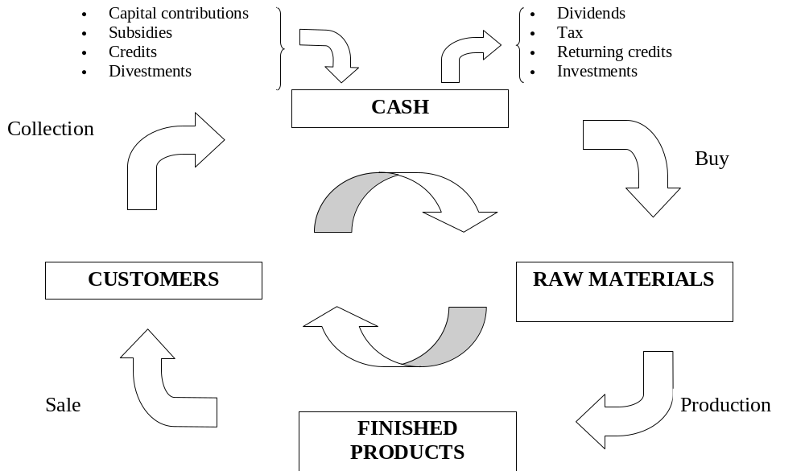
Current Assets cycle
Notes:
Comment. Very relevant. Come back to Bar Pepe, S.L. Put examples

Slide 5
Source and application of funds
Sources:
(Cash inflows)
Shareholders contributions
Short-term debt
Long-term debt
Increase in accounts to pay
Decrease in accounts to collect
Sell fixed assets
Sell products and services
Applications:
(Cash outflows)
Debt cancellations
Buy fixed assets
Increase in accounts to collect
Decrease in accounts to pay
Pay dividends or simila concepts to shareholders
Pay operational expenses
CASH
Notes:
Slide explanation.

Slide 6
Cash flow generation
Monetary
assets
Interest and
debt main
amount
Shareholders
Dividends
Moneylenders
Taxes
CASH
Debtors
for Sales
Bad
debtors
Fixed
assets
Customers
Buying cost,
Workforce,
Raw material,
Variables and Fixed
Costs
Product /
Service
Suppliers
Notes:
Explanation about the cycle of cash generation

Slide 7
Creating value for shareholders
Dividend payments
Capital gain
Notes:
How to generate value for the shareholders

Slide 8
Value network for shareholders
Company’s purpose
Create value
for
shareholders
Yield on Shareholder
Valuation
Components
Operations
Cash Flow
Discount
Rate
Debt
Growth
Sales increase
Operation margin
Societies Tax
Investment on
Working capital
Investment on
Fixed Assets
Capital cost
Value
determiners
Management Decisions
Operation
Investment
Financing
Notes:
Comments about the slide and how to generate value

Slide 9
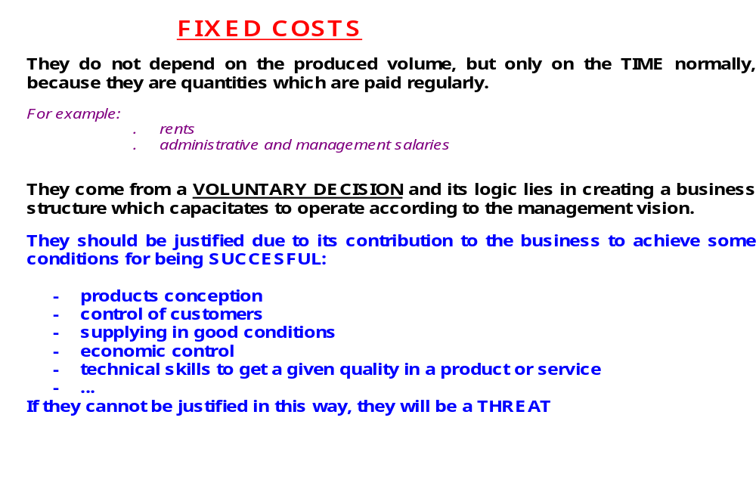
Fixed costs
Notes:
What we understand by fixed costs, be cautious

Slide 10
Fixed costs
€ (total)
Volume (units)
time
Notes:
How to represent graphically the fixed costs

Slide 11
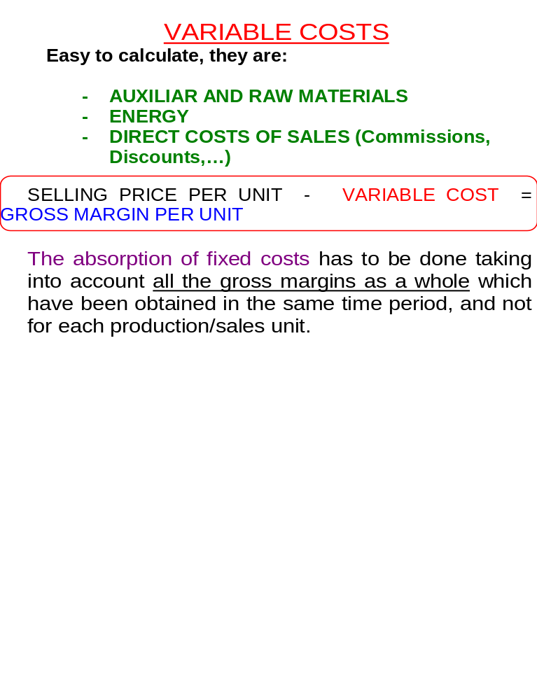
Variable costs
Notes:
What we understand by variable costs and what they represent for us

Slide 12
Variable costs
€ (total)
Volume (units)
time
Notes:
How to represent variable costs graphically

Slide 13
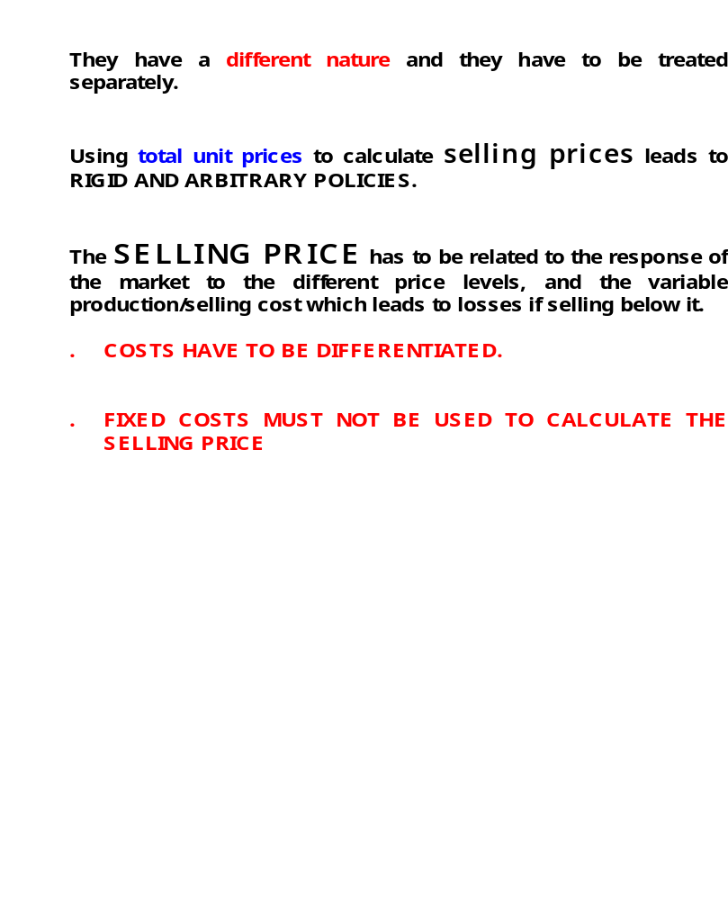
Variable costs vs. Fixed costs
Notes:
Reflection about how to use these concepts as a source to build prices

Slide 14
Break-even point
Total Fixed Costs
Contribution Margin per Unit
Break-even point volume
Contribution Margin per Unit
Income per unit – Variable costs
(€)
Total Income
Income
Total costs
Break-even point
Volume
Notes:
With sales forecasts and variable costs we can build the break-even point. Put emphasis, we must know it always

Slide 15
Business performance measurements
PROFITABILITY
IS
GB
LIQUIDITY
IS
GB
On Sales
On Assets
On Net Pat.
Current Ratio
Acid Test Ratio
BUSINESS
PERFORMANCE
MEASUREMENTS
SOLVENCY
IS
GB
EFFICIENCY
IS
GB
Solvency
Leverage
Indebtedness
Total Assets Turnover
Inventory days
Collection cycle
Productivity
IS Income Statement
GB General Balance
Notes:
Explain briefly their meaning

Slide 16
Profitability drivers
Total Costs Current Process
}
Profit
Total Costs New Process
Ingresos
}
Incremental profit
(new productive process)
150.000
Fixed Costs
76.500
New Productive Process
61.500
Fixed Costs
Current Productive Process
15.000 (Units) Volume
In 15.000 units
Current Productive Proc.
150.000 ( 15.000 x 10 ) Income 150.000
(88.500) (Variable costs ) (73.500)
(61.500) ( Fixed cost ) (76.500)
0 Net Profit 0
New Productive Proc.
Notes:
Difference in the costs analysis of two productive processes. In which circumstances is the new process better?
When we expect a sales increase which allow making the most of the operating leverage. Which is less risky? The old one because it has more variable costs.

Slide 17
Income statement. Proportional analysis.
Example
31st December 200X
Cuenta
Quantity (€)
Proportion Analysis
(% Sales)
Sales Income 60.000 100.0
Operating Expenses 40.000 66.7
Gross Margin 20.000 33.3
Adm. and commercialization expenses 10.000 16.7
Operating Gain 10.000 16.7
Financial expenses 5.000 8.3
Net Result 5.000 8.3
Notes:
An interesting method to contrast, the analysis in percentage

Slide 18
Operating leverage
Current process
New process
Income per unit
Variable cost per unit
Contribution margin
Fixed costs
Break-even point =
(Fixed Costs)
Cont. Mar.
10,00
(5,90)
4,10
61,500
15.000 un
10,00
(4,90)
5,10
76,500
15.000 un
Notes:
Explain the concept and come back to the previous explanation. It is better when we expect more sales.

Slide 19
Profitability drivers
Structure of both companies
Concept Company A Company B
Assets
€10.000
€10.000
Debt due
€ 5.000
0
Net P. (€10 per share)
€ 5.000
€10.000
Notes:
Comment it as a basis for the next slides

Slide 20
Profitability drivers
Concept
Company A
Company B
Situation
1
2
3
1
2
3
Profit
before
Tax and
Interests
1.200
800
300
1.200
800
300
Interests
400
400
400
0
0
0
Profit before
Tax
800
400
-100
1.200
800
300
Tax 30%
240
120
0
360
240
90
Net Profit
560
280
-100
870
560
210
Shares Quantity
500
500
500
1.000
1.000
1.000
Profit per Share
1,12
0,56
-0,20
0,87
0,56
0,21
Return On Equity (ROE)
112%
56%
-----
87%
56%
21%
Notes:
Comment the slide

